Slide 1

FIFA WORLD CUP DATA ANALYSIS
Registration No : 11809515 Name : Ramprawesh kumar Section : K18PV
Course Code :INT217
Course Name:Introduction to data management

Slide 2
TABLE OF CONTENT
Introduction
Dashboard
Scope of the Analysis
Source of dataset
Analysis on dataset
General Description
Analysis results
Visualization

Slide 3
INTRODUCTION
Data Analysis is a process of inspecting, cleansing, transforming, and modeling data with the goal of discovering useful information, informing conclusions, and supporting decision- making. Data analysis has multiple facets and approaches, encompassing diverse techniques under a variety of names, while being used in different business, science, and social science domains.
The analytics team of the Football World Cup association and FIFA association anywhere in the world would love to check our through data analysis of each and every match leading to a well-organized and fruitful information. My analysis contains data on host teams, all stadiums, most supported team and teams which are most successful.

Slide 4
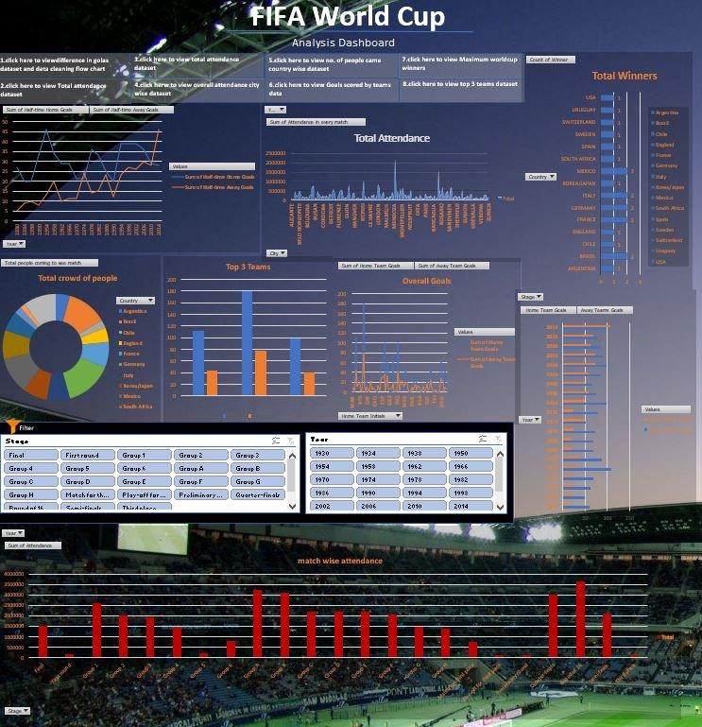
Dashboard

Slide 5
Scope of analysis
The system wants to see and analyze the sales trend month-wise and product-wise and work upon the lagging segments and outperforming employees accordingly. The Analytics team also wants to create analyze the database in depth to help the super store grow exponentially. The Analytics team wishes to answer the following objectives: -
Half time goals scored by the home and away team year wise.
No of goals scored in finals until now.
Analyzing the total attendance of crowd in Group matches, semifinals and Finals.
Overall Attendance for a particular city until now.
No. of people came to view match for particular team.
Country winning the maximum World Cups.
Goals scored by home teams and away team
Analyzing difference between total goals scored and total goals conceded by teams
Aim of this project is to answer the above objectives in the form of visualization by creating a dashboard to convey the answers effectively and efficiently.

Slide 6
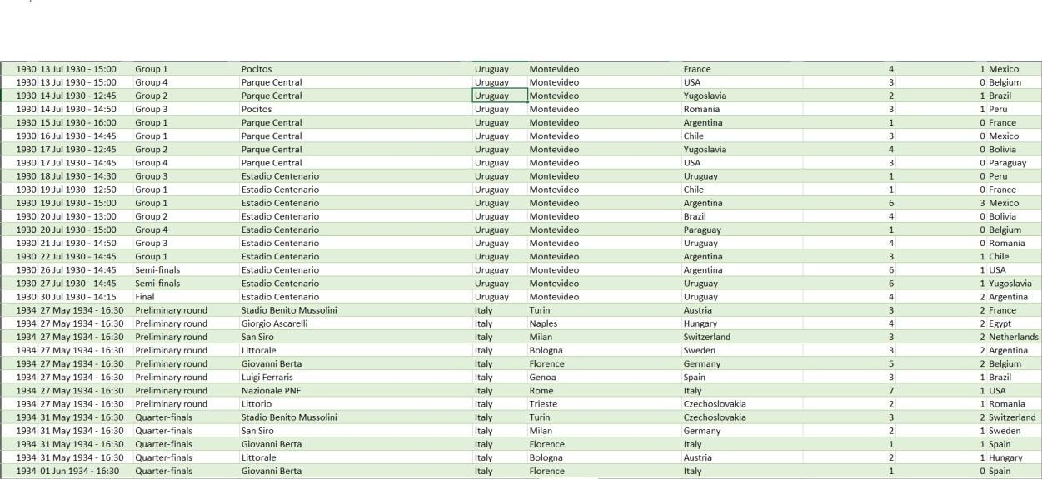
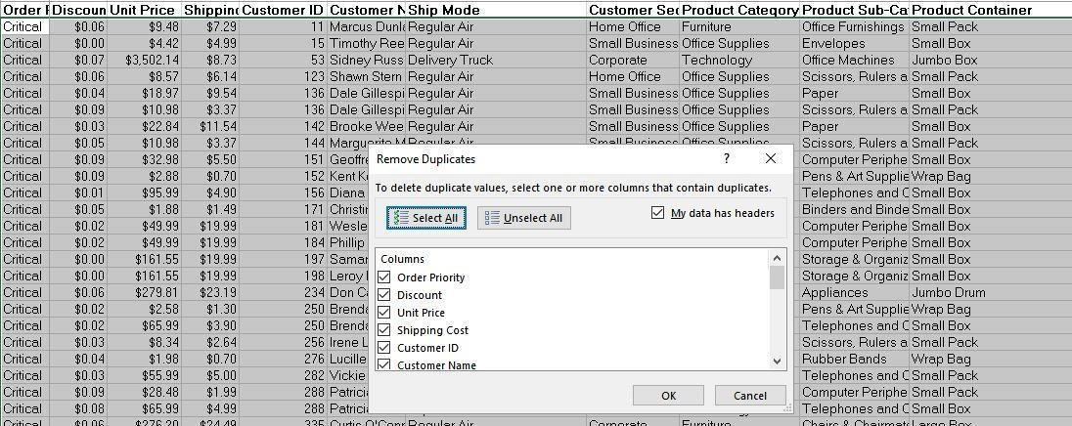
Step1.Removing blank cells from the dataset step2.removing columns which are not properly defined or not crucial to our analysis
Step3. Giving proper and appropriate column names.
Step4. Removing Duplicate Values
Step5. Improvising Proper Data Formatting

Slide 7
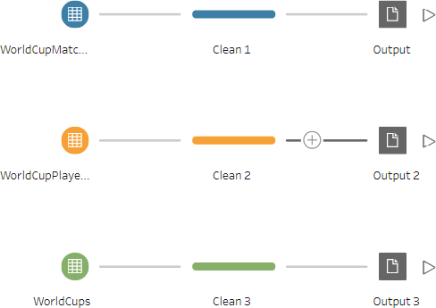
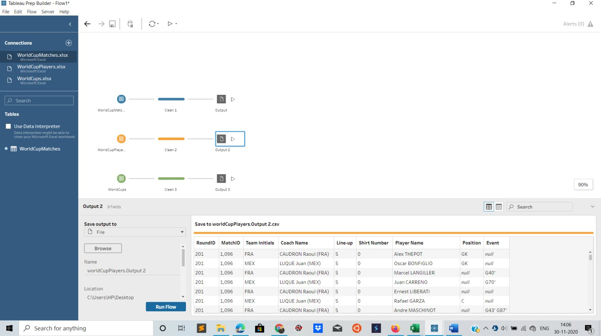
Step6. Excluding the NULL values from the data.
We’ll be using Tableau prep for this work as it’ll make the work simple and faster because we might not know how many null values could be there in this huge data set. Tableau helps us doing one step cleaning with ease.

Slide 8
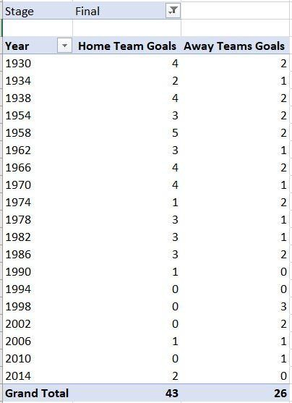
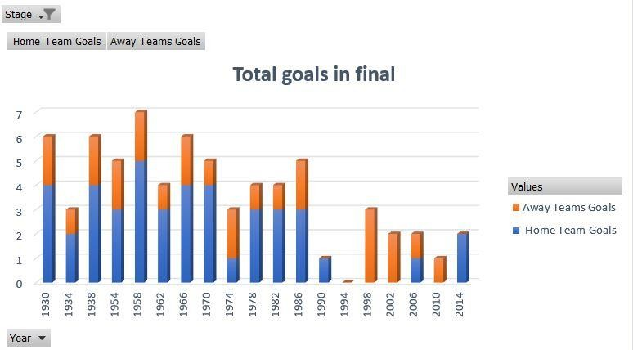
1.no.of goals scored in finals until now
Description:
By calculating the current trend of the number of goals scored by home and away teams we can check who have strategical advantage and who is going under more pressure.
Specific function and requirements
As we can see total of 69 goals scored in finals out of which 1958 having the most of 7 goals and 1994 with least of 0 goals.

Slide 9
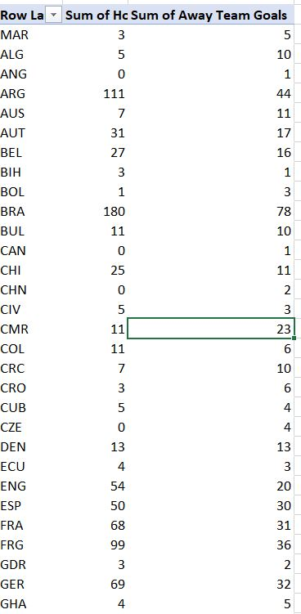
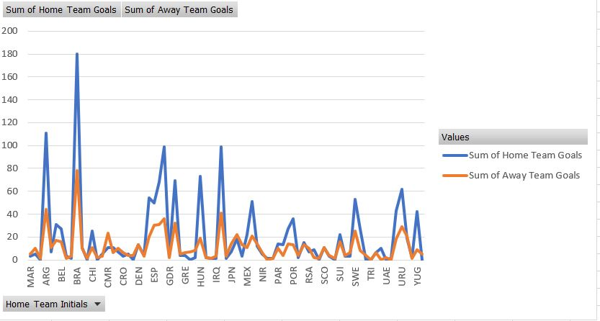
2.Goals scored by home teams and away teams
Describes the total goals scored by home and away teams and also top 3 teams scoing most goal difference.
Specific function and requirements:
We have to create a pivot table. No specific functions are used. Only a few snips of the data shown

Slide 10
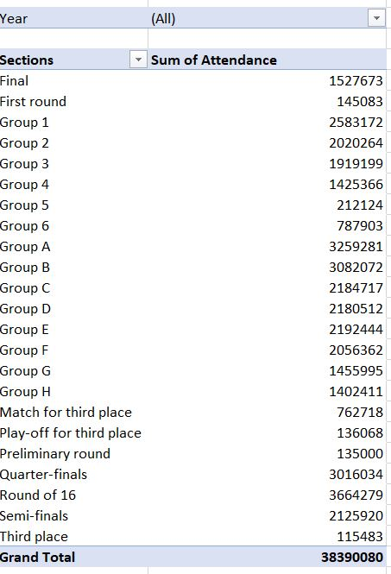
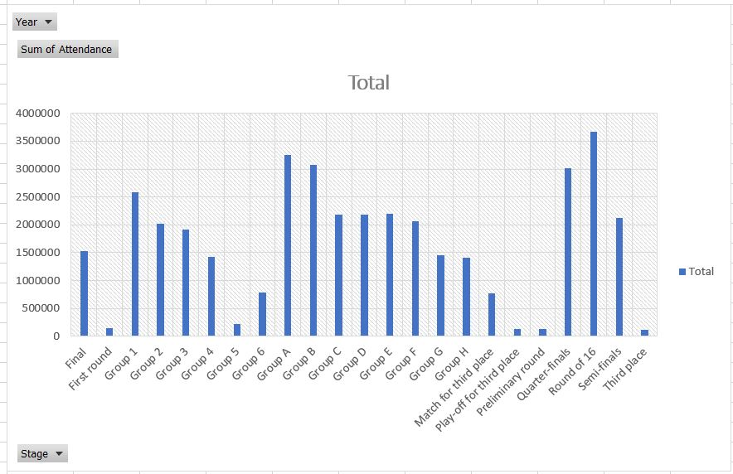
3.Analyzing the total attendance of crowd in group matches, semi-finals and finals
Describes the total attendance based on the group A,B,C,D and semifinals and finals and determining which stadium to be chosen, approx. amount of people expected security required etc.
Specific function and requirements:
We have to create a pivot table. No specific functions are used. We then put the type
of match and sum of sales in the columns.

Slide 11
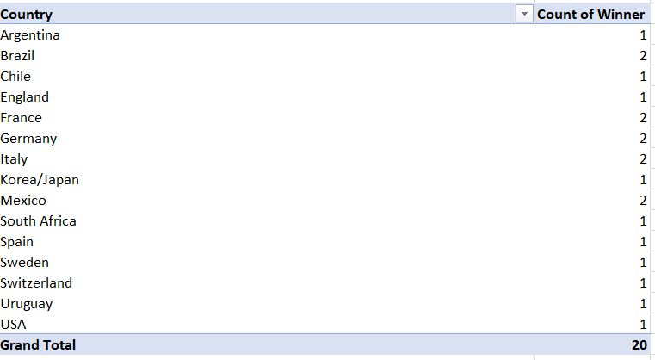
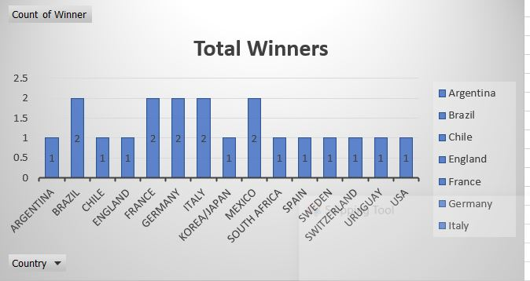
4.Country winning the maximum world cup
Description:
Determines the country with maximum FIFA world cup trophy.
Specific function and requirements:
We have to create a pivot table. No specific functions are used.

Slide 12
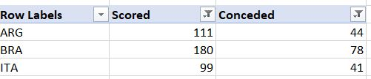
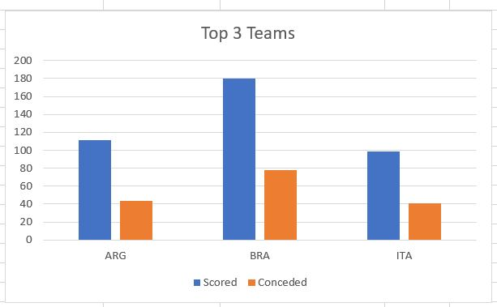
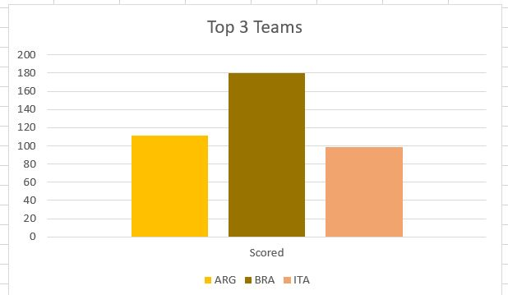
5.Analyzing difference between total goals scored and total goals conceded
Description:
Difference between goals scored and conceded by teams.

Slide 13
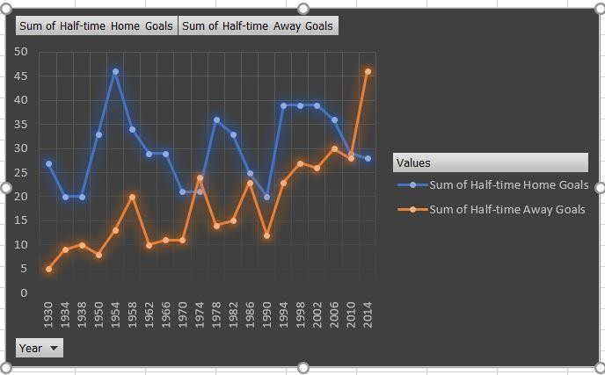
6.Half time goals scored by the home and away teams
Total number of goals scored by home and away teams year by year from the year 1930 to 2014 to depict the mental confidence and usual trend of goals scored. From the trend given below we can see home team scores 604 goals in foist half and away team scores 365 goals. There is a massive goal difference leading to home team advantage.
Specific function and requirements
We have to create a pivot table to determine the difference in goals and then visualize it on graph.

Slide 14
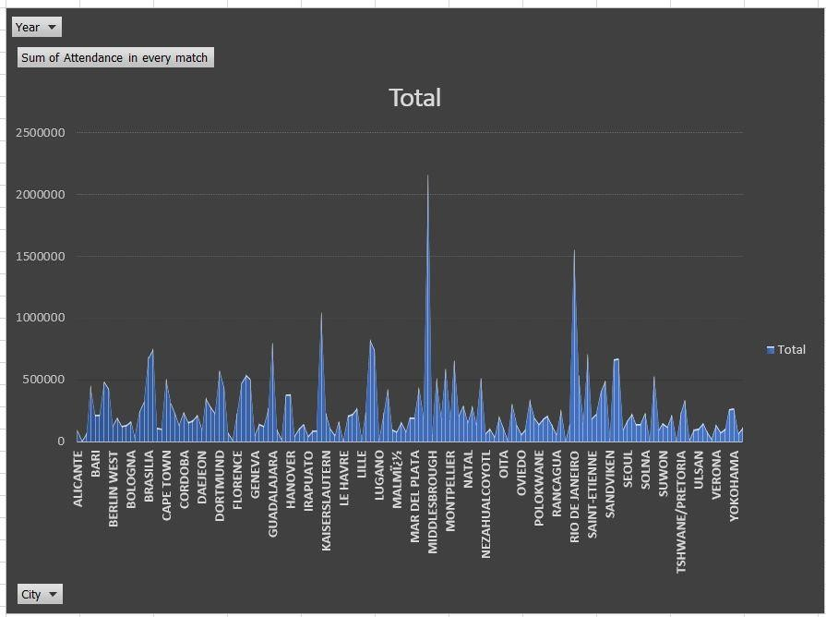
7.Overall attendance for a particular city until now
Description:
Determine the sum of attendance of all the people when they are home team.
Visualization:
We visualize the above results with the help of area chart created using area chart.

Slide 15
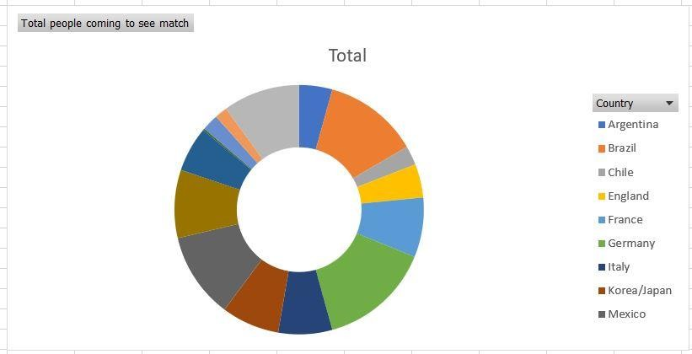
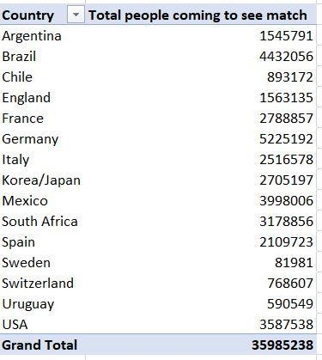
8.No. of people came to view match for particular team
Description:
By comparing the attendance of all cities we get top 5 cities with highest audience.
Specific function and requirements:
We get cities with highest fans.here we potray top 5 countries with highest attendence and snips of data.

Slide 16
9.Number of people came to view match for a particular team
Most people came to see match for brazil then argentina,Italy England and so on..

